Slide 1
Photo Backdrops Using Google Maps
Prototype Rails 2019
Steve Orth

Slide 2
Overview
Acknowledgements
Backdrops & Methods
Google Maps Streetview
Experiments with Google and Printing
Streetview 360 Download Software
Panorama Image
Image Editing
Sizing
Cropping
Removing unwanted items
Background modification
Printing
Cost Analysis
Layout Photos

Slide 3
Acknowledgements
These modelers and their backdrop methods were primary motivators
Mike Brock
UP Modeler, Vol 1
Veryl Fosnight
Wyoming Division Historical Society Layout
Pelle Solberg
Multiple articles of 3 layouts in several Kalmbach Publishing products
Bill Darnaby
Prototype Rails 2018 Clinic

Slide 4
Backdrops
Backdrops
Provide the illusion of scene depth
Are important in the giving the layout viewer a sense of space and location
Are in the background and do not need to be highly detailed, but they need to accurately depict well known landmarks
Should not draw attention to themselves… the trains are supposed to be the star of the show!

Slide 5
Backdrop Methods
Hand painted
Good at giving the illusion of depth
Can give the layout viewer a sense of space and location
Are likely to not be highly detailed
Accurately depicting landmarks can be challenging
Should not draw attention to themselves… but they might if they don’t look very good
Photo backdrops
Good at giving the illusion of depth
Can give the layout viewer a sense of space and location
May or may not be highly detailed
Will accurately depict landmarks
Should not draw attention to themselves… but they might if they are too spectacular

Slide 6
Backdrops
I believe goals can be achieved with a medium resolution image photo backdrop
Commercial backdrops are available
Most are well done
Selection is limited
Some are silly… for example Bryce Canyon
What if we could get images of our location without traveling there?

Slide 7
Google Maps Streetview
Google Streetview was launched in 2007 and has since expanded to include cities and rural areas worldwide
Most recent update in the US was Oct 2018
Coverage in the US appears to me to be nearly 100%
Google’s cameras were upgraded in 2017, using eight 20 Mpixel sensors, prior cameras used fifteen 5 Mpixel sensors
Cameras are mounted on cars, fixed mounts, backpacks, trikes, snowmobiles
Locations with Street View imagery available are shown as blue lines on Google Maps or a blue circle for a fixed “Photo Sphere”

Slide 8
Google Map Satellite View
https://www.google.com/maps/place/Green+River,+WY+82935/@41.5269844,-109.4689619,755m/data=!3m1!1e3!4m5!3m4!1s0x875a7de1e1298c47:0xd8cbacd7ddf44cf8!8m2!3d41.5285757!4d-109.4662461

Slide 9
Experiments - Google View from Croydon Road

Slide 10
Experiments with Google and a Laser Printer
Single Google Streetview image
No editing
Printed on multiple 8.5 x 11 photocopy paper sheets taped together

Slide 11
Experiments with Google and a Laser Printer
I was encouraged to proceed with more advanced methods!

Slide 12
Streetview Images
Streetview images are panoramas of stitched images, we need a way to capture these panorama images with full resolution
Streetview Download 360
“Software for downloading 360* panoramas from Google Street View”
Shareware… it’s free, but you should donate. ☺
Available for Windows or Mac
https://svd360.istreetview.com/

Slide 13
Streetview 360 Download
This was developed by a high school student and the search feature became too expensive for him, but we can work around that
How to use it:
Find the Google Street View panorama you want to download using Google Maps.
Copy the URL.
Go to iStreetView.com and paste the URL into iStreetview and click “Load”.
Copy the panorama ID.
Download and open the app “Street View Download 360”.
Paste the panorama ID, select the location on your computer to save the file to, select the image resolution and click “Download Panorama”.

Slide 14
iStreetview – Load a Panorama

Slide 15
Google Map Satellite View of Green River
https://www.google.com/maps/place/Green+River,+WY+82935/@41.5269844,-109.4689619,755m/data=!3m1!1e3!4m5!3m4!1s0x875a7de1e1298c47:0xd8cbacd7ddf44cf8!8m2!3d41.5285757!4d-109.4662461

Slide 16
iStreetview – Paste the URL of the Panorama
3. Go to iStreetView.com and paste the URL into iStreetview and click “Load”.

Slide 17
iStreetview – Copy the Panorama ID
4. Copy the panorama ID.

Slide 18
iStreetview – Homepage
5. Download and open the app “Street View Download 360”.
6. Paste the panorama ID, select location to save, image resolution and click “Download Panorama”.

Slide 19
Open the Panorama Image file
This panorama image file is a full resolution image file that can be manipulated in Photoshop Elements or other photo editing programs

Slide 20
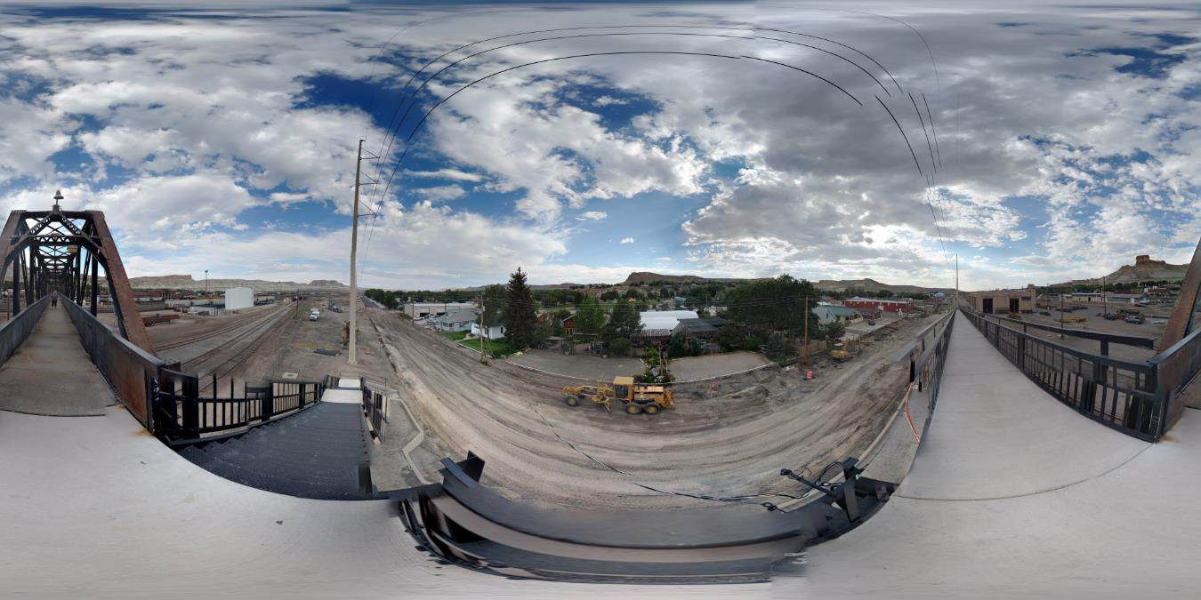
Initial Image Processing
Crop the image to capture what is needed for a backdrop
I used “Paint” for cropping

Slide 21
Cropped Panorama Image

Slide 22
Photo Editing Software
Photoshop Elements 2019
Very powerful, relatively simple photo editing software
Can be downloaded for $69.99
Paintshop Pro
Powerful, also relatively simple to use
Can be downloaded for $48.47

Slide 23
Resizing the Image
Click on the “Expert” tab to enable all the editing features

Slide 24
Resizing the Image

Slide 25
Image Cropping

Slide 26
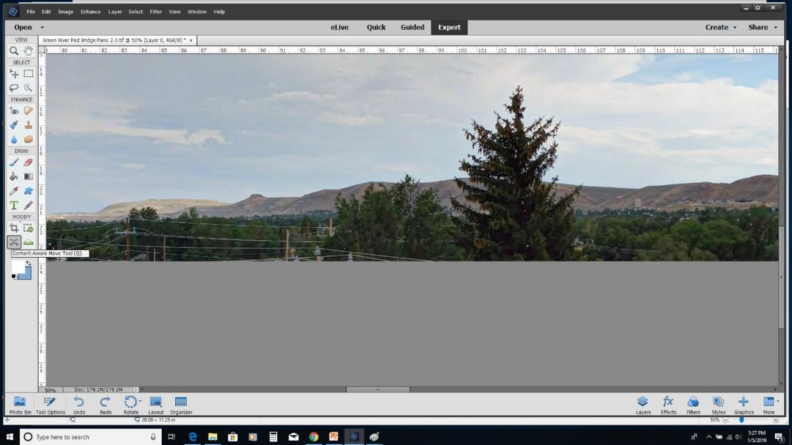
Removing Items
Sometimes (always?) our image will have items we want to remove – like this foreground tree
Photoshop has powerful tools that make this easy

Slide 27
Removing Items – Content Aware Tool
Select the item you want to remove
This doesn’t have to be precise, the Lasso tool works well

Slide 28
Removing Items – Content Aware Tool
Under Edit, choose File Selection
In the Use area, pull down to Content Aware
Click Okay

Slide 29
Removing Items – Tree Is Gone!

Slide 30
Removing Items
Tree, buildings, and utility poles have been removed
Small items, such as the power wires, can be moved with the Clone Stamp Tool

Slide 31
Removing Items – Clone Stamp
Select an area you want to clone, hold the Alt key and click
Click on what you want to cover
Stamp size can be adjusted in the toolbar, along with other attributes

Slide 32
Cleaned Up Image
Tree
Fuel storage tank
Large Utility Pole

Slide 33
Background Removal – Quick Selection Tool
Quick Selection Tool allows you to easily select items to move to a different layer
Click on an edge of what you want to keep and drag to select
Cut selection from image

Slide 34
Create a New Layer
Under Layer, select New > New Layer
Paste clipboard content into new layer
Crop as required

Slide 35
Create a New Background with a Solid Color
Create a 2nd New Layer
Layer > New Fill Layer > Solid Color
Select the color of choice

Slide 36
New Background
Layer > Background from Layer

Slide 37
Test Print File
Crop the file down to make a test print file
Important to check for size, brightness, contrast
Save the file in an appropriate format for your print shop

Slide 38
Echo, UT Test Print

Slide 39
Green River 1952

Slide 40
Green River Test Print
Time to Print!

Slide 41
Printing
Print shops that print posters and signs can print your file with a 6 color printer
I use FedEx
Preferred file format is a “Photoshop PDF”
Will have the print back in the shop in 2 business days
Can print on several materials
Normal paper
Poster paper (smoother surface, thicker)
0.020” white styrene
I chose styrene
Waterproof
External sign UV resistant inks
Will not wrinkle
Will stand by itself
Can be retained with double-sided tape
Can be removed and reused if layout is rebuilt

Slide 42
Combining Images
Prints will be 24” high, so I combined two images on one print
Reduced final backdrop per linear foot cost in half

Slide 43
How Much Does this Cost?
Printing cost for 52 ft of backdrop $572
Cost per ft $11/ft
Comparable commercial backdrops on adhesive vinyl are $9 per sq ft and are 24” tall
52ft x 2ft = 104sqft x $9.00 = $936
Cost per ft $18/ft

Slide 44
How does it look?

Slide 45
Green River Overall View

Slide 46
West Green River

Slide 47
Roundhouse

Slide 48
Coal Chute & Overland Lumber

Slide 49
Oil House & Storehouse

Slide 50
Storehouse

Slide 51
Pedestrian Bridge

Slide 52
Car Shop & Wreck Train

Slide 53
Freight Yard

Slide 54
Depot

Slide 55
Freight Yard

Slide 56
Center Green River

Slide 57
Center Green River

Slide 58
Center Green River

Slide 59
East Green River

Slide 60
East Green River

Slide 61
East Green River

Slide 62
Crossing Bitter Creek

Slide 63
Bitter Creek Crossing

Slide 64
Questions?

